Slide 1

An Organization Tool

Slide 2
Group Members
180041208
Fida Kamal
Programmer & UI/UX designer
180041223
Shah Jawad Islam
Programmer & UI/UX designer
180041229
Alvi Aveen Khan
Programmer

Slide 3
Overview
Problem
Solution
Glorified notepad applications
Organized environment
Take notes, organize files, set reminders, task management, etc.
Organizational features of different applications
(Notepad, file managers, project management tools)
Unified organizational tool
Existing Programs

Slide 4
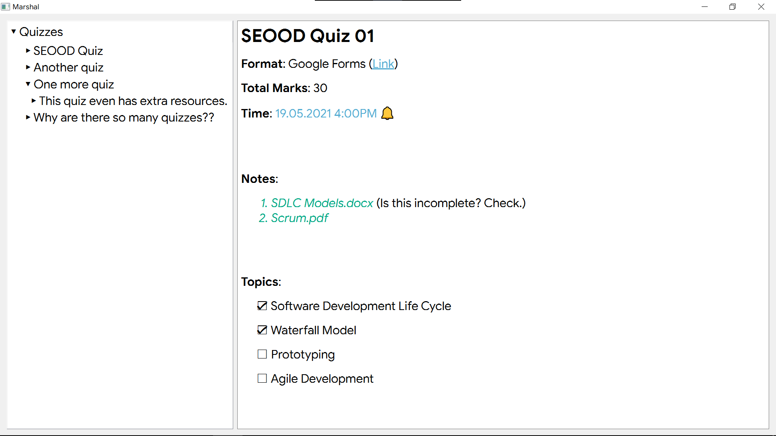

Slide 5
Features
01
02
03
04
05
06
Notes in rich text.
Files alongside text in notes
Hierarchical view
Basic organization tools
Advanced task management tools
Collaboration tools

Slide 6
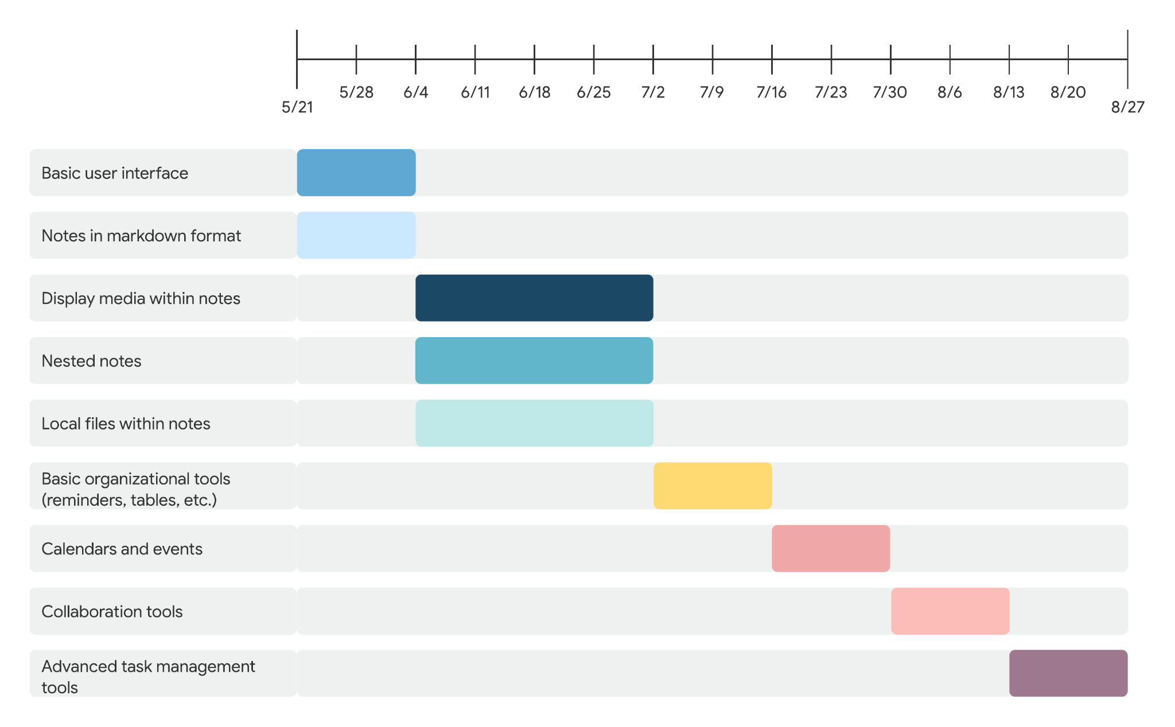

Slide 7
Thank you

